Slide 1
Energy and Power
Melanie Richardson

Slide 2
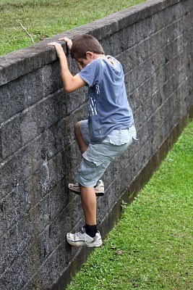
Climbing a Wall
A male that is 71 kg decides to climb a 20m wall. He completes this task in 120 s.
Energy = Work = mgh = 71kg x 9.8m/s^2 x 20m = 13,916J
Power = E/time = 13,916J/ 120s = 115.97 Watts
Average mass of a 20 year old male found on wikipedia.org

Slide 3
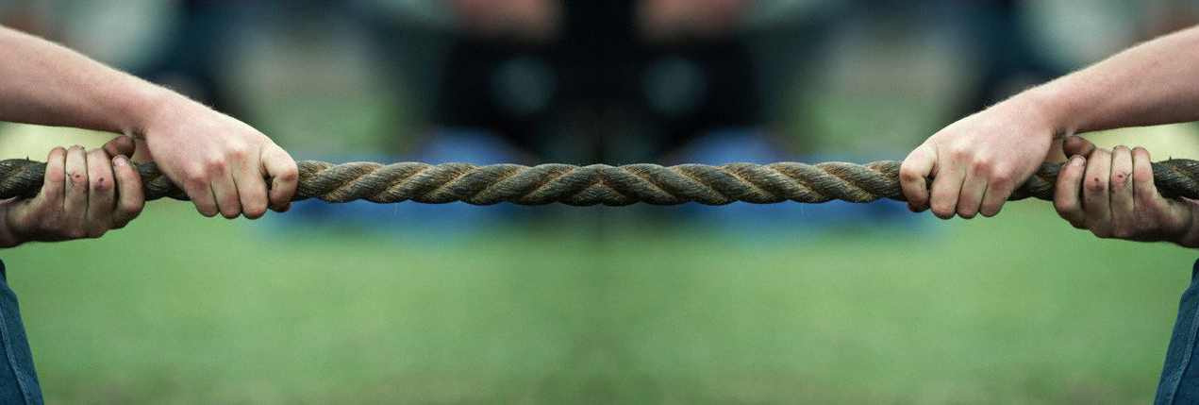
Tug of War One team exerts a force of 500N, while the other team exerts a force of 600N. The rope must move 2m in either direction for a team to win. The tug of war ends with team 2 finishing in 15 seconds.
Team 1
Team 2
Work = F x d = 500N x 2m = 1200J
Power = 1200J/15s = 80 Watts
Work = F x d = 600N x 2m = 1000J
Power = 1000J/15s = 66.7 Watts
Total Work = 1200J + 1000J = 2200J
Total Power = 80 W + 66.7 W = 146.7 W
Information for force found in an online physics problem

Slide 4
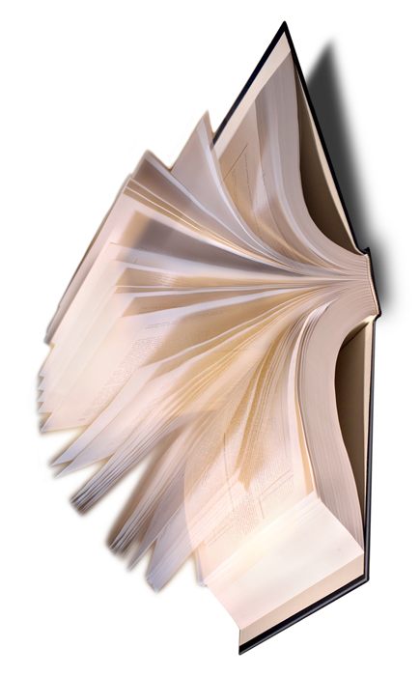
Turning a book page
A book that is .3556m long when open has a half-circumference of .559m, which is the distance the page will travel when turning. The weight of the paper is .7g or .0007kg and it takes 1.4s to turn the page.
F = ma = .0007kg x .285m/s^2 = .0001995N
Work = Fd = .0001995 x .559m = .000115J
Power = Work/time = .000115J/ 1.4s = .0000821 Watts
Information found on wiki.answers.com

